Slide 1
Analysis of 2011-12 Undergraduate Compliance Assist! Data
Rajeeb Das, Senior Assessment and Evaluation Specialist

Slide 2
Methodology
Compliance Assist!
Undergraduate catalog catalog.ufl.edu/ugrad/1112
Academic Assessment Plans downloaded from the approval system approval.ufl.edu

Slide 3
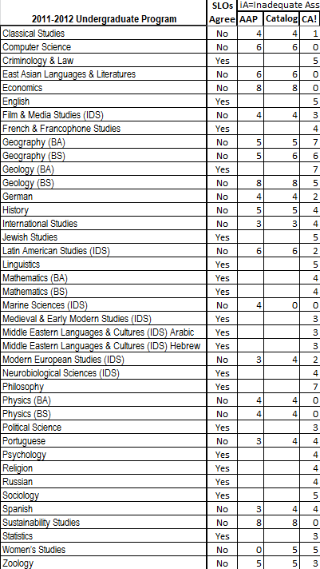
Findings
118 undergraduate degree programs in 2011-12
65% of programs had the same number of SLOs in the undergraduate catalog, Academic Assessment Plan, and Compliance Assist!
35% did not
Example: Anthropology listed 20 SLOs in the catalog, 14 in the AAP, and 7 in CA!

Slide 4
Findings
Most frequent citations in descending order
Inadequate Results
Inadequate Use of Results
No data reported at all
Almost all programs would benefit from clearer descriptions of reported data
CA! data should stand alone and be understood outside the unit

